Slide 1

Normality, Databases and You

Slide 2
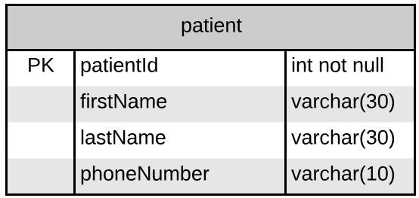
Let’s think about patient
Let’s assume that we get a requirement to add multiple phone numbers. How could we do that?
One approach is to expand phoneNumber to varchar(50) and use a comma separated list.
Opinions?

Slide 3
This used to be a common approach…
In databases, we consider this to be “denormalized” – the data is not normal (in a common format).
This form is harder to search and to work with in SQL.
We prefer a normalized approach.

Slide 4
The wrong fix
We could split phoneNumber into phoneNumber1 and phoneNumber2. That would “fix” the problem.
Until we needed phoneNumber3, phoneNumber4 and phoneNumber5.
Then, what happens when someone has 5 phone numbers, then deletes #2 and #3? Do we shift the others left?

Slide 5
The mechanical fix…
Another approach is to not change the database at all.
Create records like this:
patientId | firstName | lastName | phoneNumber
1 | John | Smith | 518-555-1212
1 | John | Smith | 518-555-2323
2 | Tim | Thompson | 518-555-3456
Since a primary key has to be unique, what is the primary key on this table?

Slide 6
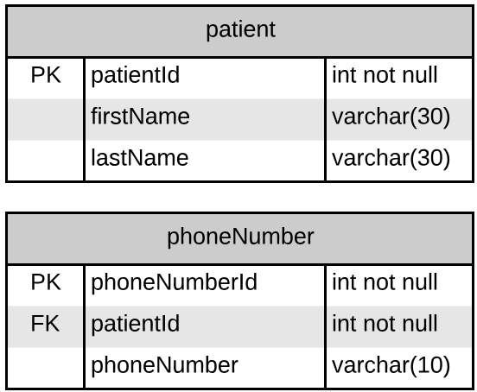
The right fix
First Normal Form (1NF) In the first normal form, only single values are permitted at the intersection of each row and column; hence, there are no repeating groups.
To normalize a relation that contains a repeating group, remove the repeating group and form two new relations.

Slide 7
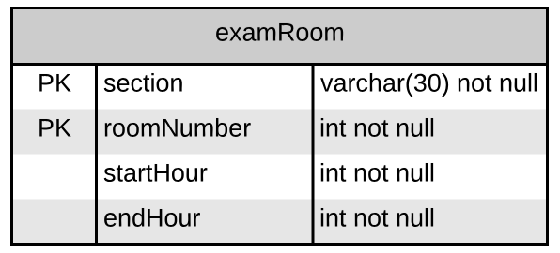
Let’s consider exam room
Let’s assume that our hospital has sections named by color: yellow, red, blue, green. Exam rooms are numbered within the sections. Each section has hours of operation.
Consider an exam room table:
(“blue”, 5,8,17)

Slide 8
Problem? 2nd Normal Form!
The non-primary-key data (startHour, endHour) depends on only part of the primary key (the section, not the room).
This is unnecessary duplication of data. The formal definition of 2nd Normal Form is:
For the second normal form, the relation must first be in 1NF. The relation is automatically in 2NF if, and only if, the PK comprises a single attribute. If the relation has a composite PK, then each non-key attribute must be fully dependent on the entire PK and not on a subset of the PK (i.e., there must be no partial dependency or augmentation).
I like this: look at each of the table’s columns and ask yourself, “Does this column serve to describe what the primary key identifies?”

Slide 9
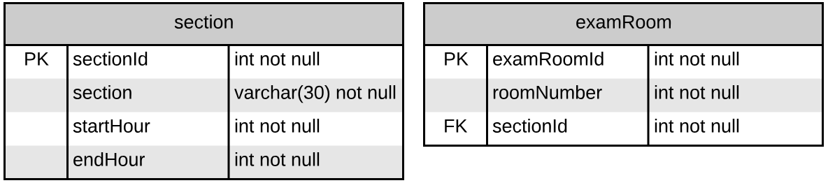
Solution!
The way to fix this is to split the table:

Slide 10
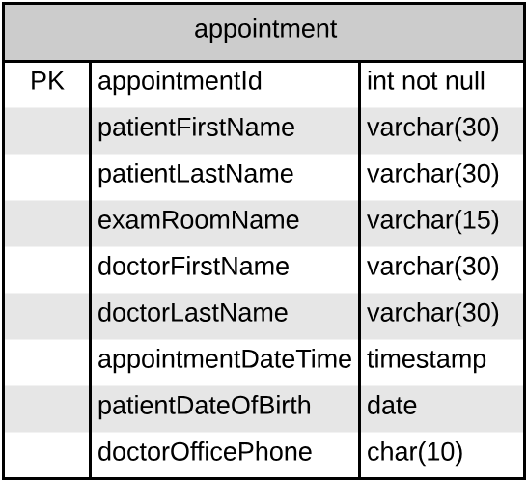
Appointment
Consider an appointment table
that looks like this:
Of course, there is a problem… What is it?

Slide 11
Transitive Dependencies!
patientDateOfBirth depends on (patientFirstName, patientLastName)
doctorOfficePhone depends on (doctorFirstName, doctorLastName)
This is a violation of 3rd Normal Form:
To be in third normal form, the relation must be in second normal form. Also all transitive dependencies must be removed; a non-key attribute may not be functionally dependent on another non-key attribute.

Slide 12
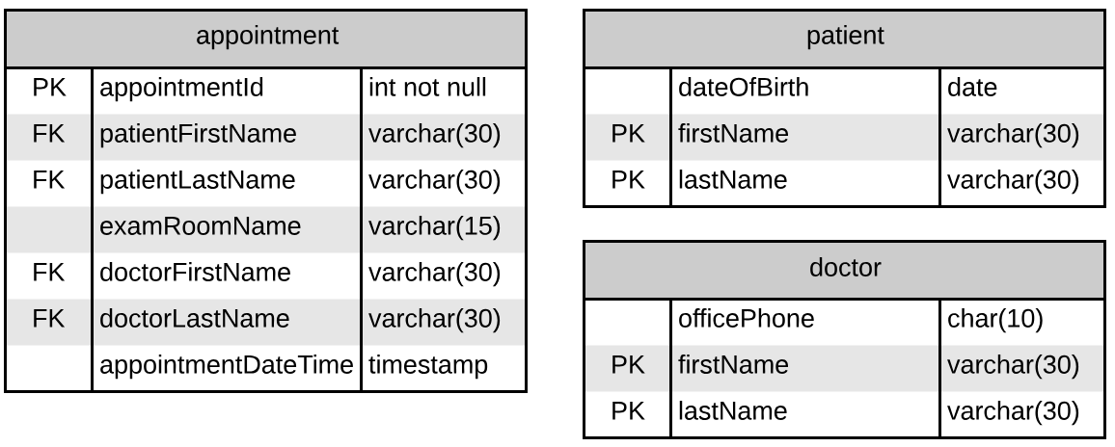
The Solution(ish)
The minimal fix for this is to make two new tables:

Slide 13
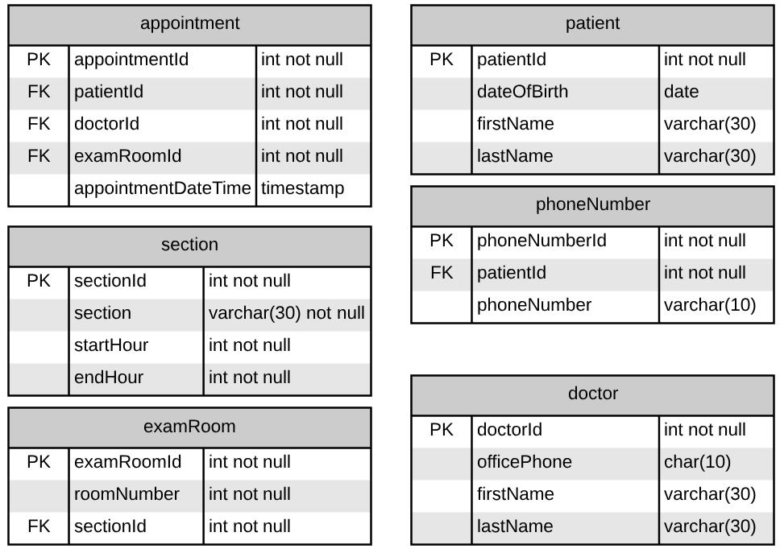
What’s wrong with this?
The keys are ugly (in my opinion). Every time someone changes their name (for whatever reason), you end up having to ripple changes through your database. A better design for this:

Slide 14
One More Level
We get a requirement to track the specialty for the appointment.
We might think that we can attach specialty to the doctor table. The product owner informs us, though, that some doctors have more than one specialty (example – cardiologist might also be surgeon).
How might we handle this?

Slide 15
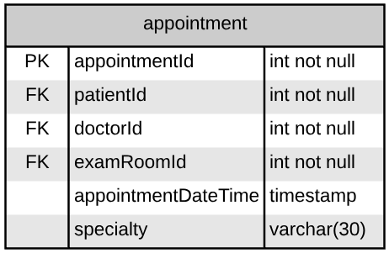
How about this?
This is not the worst design, but there is a problem. Specialty can be anything and any doctor can have any specialty.
More formally, the specialty depends on the doctorId (a determinant), but is not part of the candidate key.

Slide 16
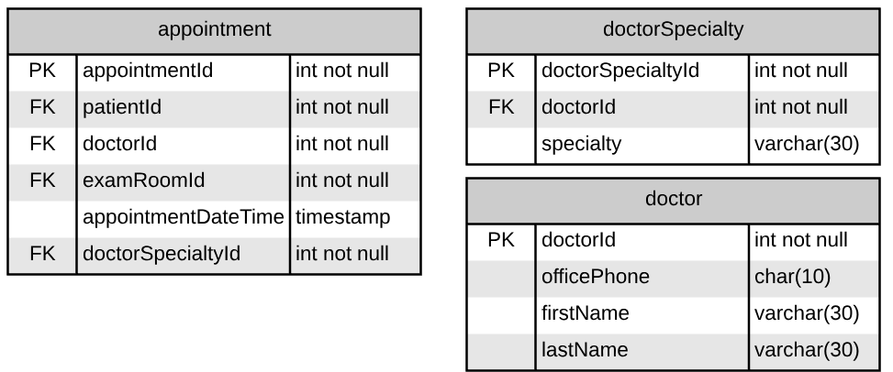
Boyce-Codd Normal Form
Formally: There can be no dependencies unless the data item depended on is part of the superkey.
Informally, you really want to have some way to know, track and enforce what the valid combinations are.

Slide 17
General Rules
Don’t repeat yourself
A table should represent one and only one thing
When two entities intersect, create a table to join them (doctorSpecialty) if you need to track which combinations are valid
Use surrogate keys
Name your tables and columns well

Slide 18
Deleting Records
The model that we are looking at has a LOT of foreign keys.
When the software first goes “live”, this looks great.
What happens in 3 months when a doctor retires?
Since there are appointments and specialties with his record attached, we can not delete his record. Further, he shows up in all of the drop downs in the system for picking a doctor…

Slide 19
Option #1 : Nuke All The Things
Delete all of his appointments, doctorSpecialty records, etc.
This is usually unacceptable to the organization – they will make the point that people need to see history. We wouldn’t want ½ of a patient’s history to disappear because one of their doctors left the practice.

Slide 20
Option 2: Add IsDeleted to all the things
A simple, Boolean flag. What could go wrong?
In some simple cases, this is not unreasonable, but it does lack one thing – a reason. We can’t tell WHY the doctor is no longer valid. Did they retire? Quit? Die? Go to jail? Or were they just entered into the system twice and this is a duplicate record?

Slide 21
Option #3: Status all the things
Add a “status” column to all of those tables.
Check for a status of “active” everywhere in your code, SQL, etc.
This is a lot of work, but solves the problem from option 3.
What it doesn’t tell you is who made the change and why. “Dr Jones is NOT retired – who said that he was?”

Slide 22
Option 4: The 5 W’s
(Who, What, When, Where, Why)
Add Status, CreatedDate and CreatedBy columns.
Now we can track the most recent change and who did it.
But we still don’t have HISTORY – only the latest change.

Slide 23
Option 5: Make the record (mostly) write once
What if we add those fields (Status, CreatedDate and CreatedBy) and have a business rule that says “never change a row. Clone the row with the new data, then set the status on the old record”.
doctorId | firstName | lastName | Status | CreatedDate | CreatedBy
1 | Tanya | Smith | Active | 1/1/2017 | mphipps
doctorId | firstName | lastName | Status | CreatedDate | CreatedBy
1 | Tanya | Smith | NameChange | 1/1/2017 | mphipps
2 | Tanya | Jones | Active | 1/1/2019 | mphipps
How can I search for all of Tanya’s appointments?

Slide 24
Option 6: Add a “replaces” column
We can add another column so that we can trace the whole history:
doctorId | firstName | lastName | Status | CreatedDate | CreatedBy | replaces
1 | Tanya | Smith | Active | 1/1/2017 | mphipps | null
doctorId | firstName | lastName | Status | CreatedDate | CreatedBy | replaces
1 | Tanya | Smith | NameChange | 1/1/2017 | mphipps | null
2 | Tanya | Jones | Active | 1/1/2019 | mphipps | 1
Are you kidding me? I can’t write code for that pattern for every table!

Slide 25
Option 6A: Create ANOTHER unique ID
What if the doctor had a unique Id that wasn’t the primary key?
doctorId | firstName | lastName | Status | CreatedDate | CreatedBy | licenseNo
1 | Tanya | Smith | Active | 1/1/2017 | mphipps | 1234
doctorId | firstName | lastName | Status | CreatedDate | CreatedBy | licenseNo
1 | Tanya | Smith | NameChange | 1/1/2017 | mphipps | 1234
2 | Tanya | Jones | Active | 1/1/2019 | mphipps | 1234
Pros: Finding all of Tanya’s appointments is a little easier.
Cons: Dealing with another ID
There is nothing to enforce licenseNo matching Tanya

Slide 26
Option 7: An archive table
If there are no foreign keys TO a table (say, appointment), you could make a “appointmentArchive” table with the same schema.
Instead of just deleting a record, you could save a copy to the archive table first.

Slide 27
Which one should I use?
Depending on the need, I have used most of these in real life.
I tend to put CreatedBy and CreatedDate on every table UNLESS it is a simple key value pair table (thingId, thingName) for tracking purposes anyway.
After that, replaces vs uniqueId is a matter of which makes more sense. Status could also be “replaceReason” if that makes more sense.
Another thing to consider – sometimes there are legal reasons to HAVE to delete data.

